Slide 1

Optimizing Hospital Costs: A Data-Driven Approach to Readmissions

Slide 2
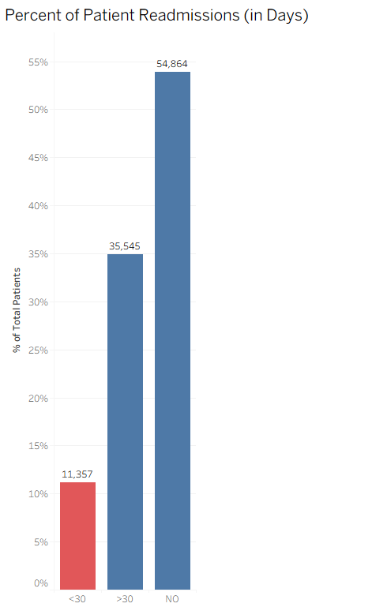
Status Overview
~100,000 US hospital encounters over 10 years
Key Problem:
Hospital readmissions within 30 days trigger financial penalties from insurers & regulators
Hospitals don’t get paid again for the readmission
These readmissions increase costs and reflect potential gaps in patient care
Current Situation
53.9% of patients were not readmitted
34.9% were readmitted after 30 days (no penalty)
11.1% were readmitted within 30 days → costly & penalized

Slide 3
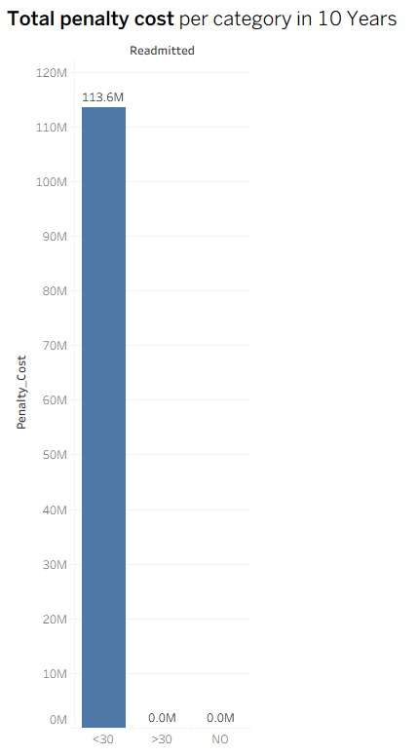
Total Penalty Cost
Cost per readmission:
Readmitted <30 days → penalty cost $10,000 per case
Readmitted >30 days → no penalty .
No readmission → $0 penalty
Based on U.S. healthcare reports
Average hospital admission (treatment cost): ≈ $11,000 per patient.
Medicare penalty for readmission <30 days: up to $10,000 per case.

Slide 4
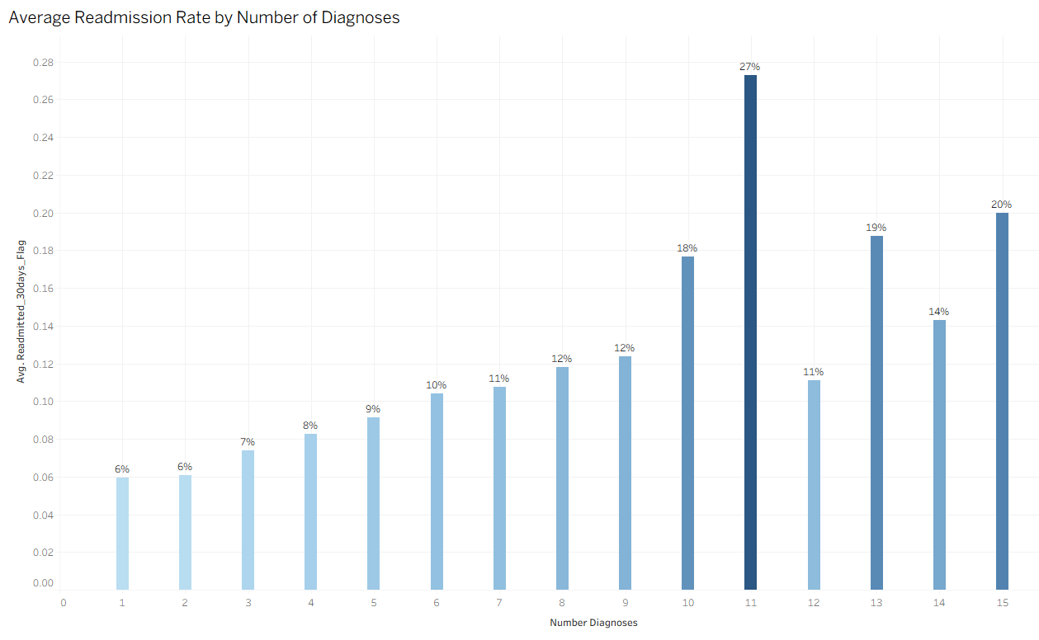
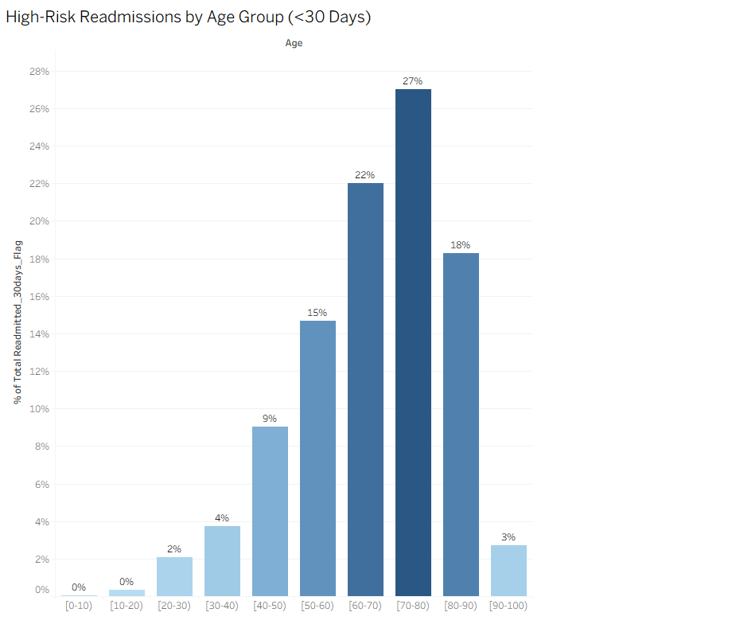
Possible Reasons
Age
Multiple Diagnoses
Key Insight: Older patients with multiple diagnoses who are discharged home are the most likely to be readmitted within 30 days.

Slide 5
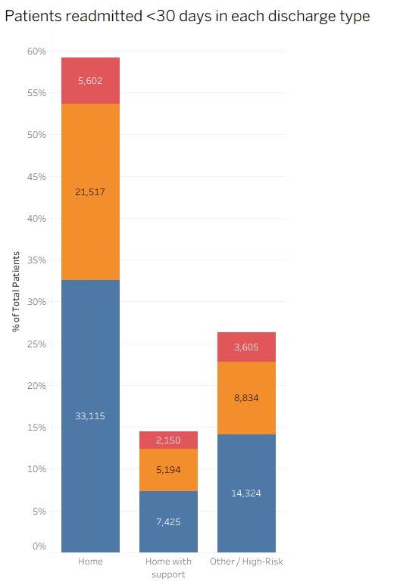
Discharge Type
Category | Meaning
Home | Patients discharged home without additional support
Home with support | Patients discharged to rehab, skilled nursing, or home health services
Other / High-Risk | Patients discharged to other hospitals, left AMA, or hospice
Patients discharged to home without support have the highest proportion of <30-day readmissions (10%), while patients discharged to care facilities or with follow-up support have fewer early readmissions (2%).
Red = <30 days (early readmission)
Other colors = >30 days or NO readmission

Slide 6
Possible Solution
Implement a targeted follow-up care program for this group → reduces readmissions, lowers penalties, improves outcomes.
*Reminder:
Based on U.S. healthcare reports
Average hospital admission (treatment cost): ≈ $11,000 per patient.
Medicare penalty for readmission <30 days: up to $10,000 per case.
Follow-up care program cost (home visits, telehealth, checkups): ≈ $1,500 per patient.

Slide 7
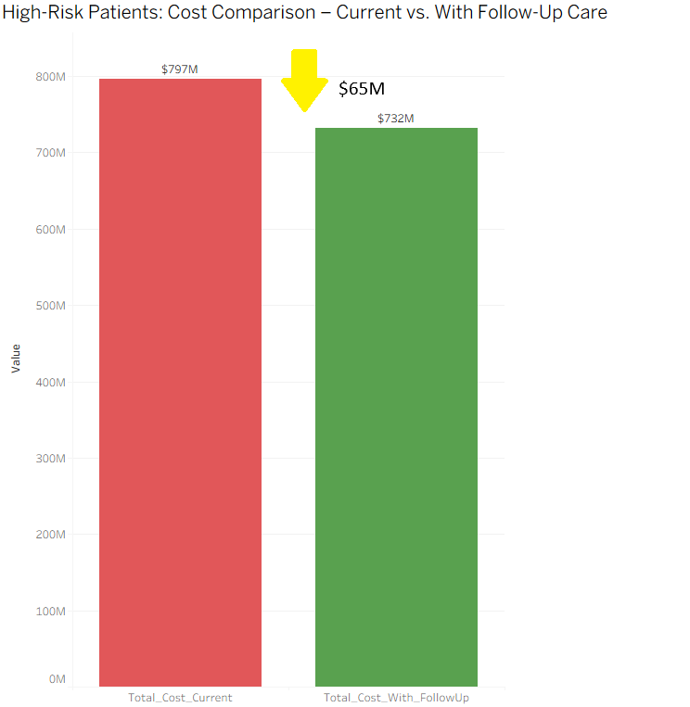
A/B Testing
High-Risk Criteria
Age ≥ 60 → older patients
Number of Diagnoses ≥ 3 → multiple chronic conditions
These criteria identify the patients who are most likely to be readmitted within 30 days.
Group A (Control): High-risk patients receive standard discharge care (no follow-up program).
Group B (Treatment): High-risk patients receive follow-up care program (calls, telehealth, reminders, home visits).
Total_Cost_Current = [Treatment_Cost] + [Penalty_Cost_Current]
Total_Cost_With_FollowUp = [Treatment_Cost] + [FollowUp_Cost]

Slide 8
Conclusion
Current Situation: High-risk patients (older + multiple diagnoses) cost hospitals $797M due to treatment and penalties from 30-day readmissions.
With Follow-Up Care: Implementing a targeted follow-up program reduces total costs to $732M, saving $65M.
Key Insight: Investing in a follow-up care program for the high-risk group significantly reduces penalties, improves patient outcomes, and is cost-effective.
Revenue Perspective:
By preventing costly readmissions, hospitals protect revenue and avoid penalties, effectively turning a potential loss into $65M in savings in 10 years -> $6.5M in one year.

